Slide 1

IMMERSISPACE
Design your dream compound in 3D — simply, smartly, instantly.
Hackathon:
CODE SURFERS
VIBE REVIEW
Notes:
1

Slide 2
The Problem: Complex & Costly Compound Design
Designing a compound layout is traditionally a complex and time-consuming process. Existing professional tools are powerful but come with significant barriers:
High Cost
Expertise Required
Lack of Real-time Visualization
Software licenses for tools like AutoCAD or Blender are expensive.
Steep learning curves demand specialized skills, excluding most everyday users.
Interactive 3D editing and instant visualization of changes are often missing.
Beginners cannot easily visualize or customize compound walls, swimming pools, or lawns interactively, making the design process inaccessible.
Notes:
3

Slide 3
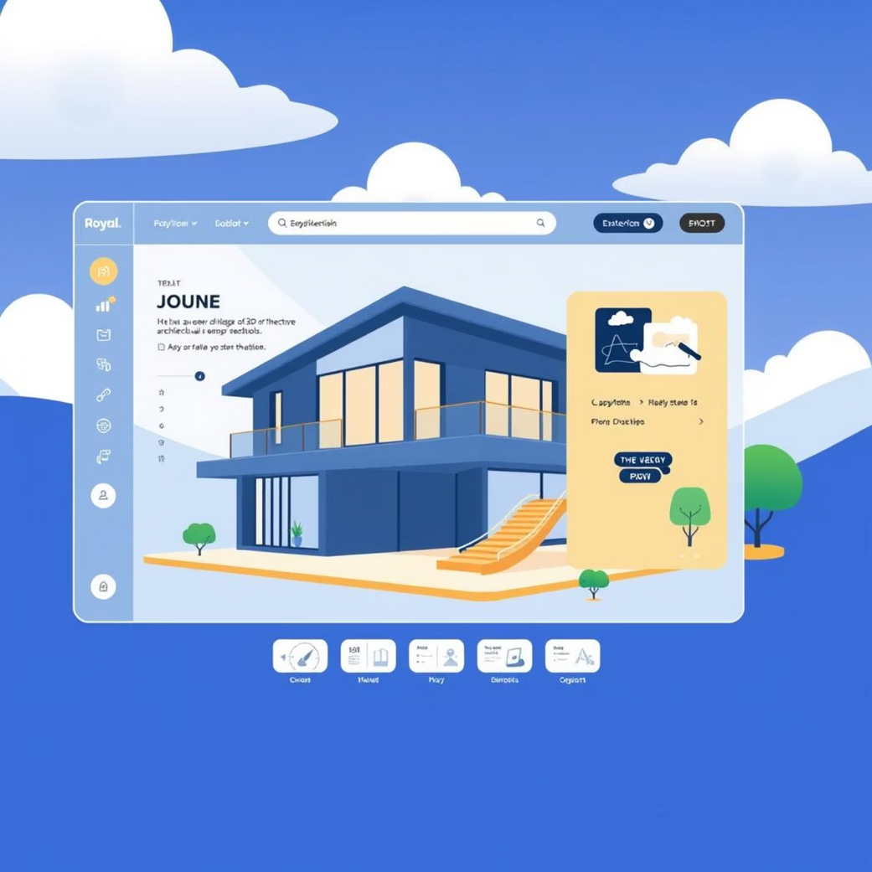

Our Aim & Vision: Accessible 3D Architectural Design
Our Aim
Our Vision
To build an intuitive, web-based 3D compound layout designer with real-time editing, prebuilt templates, and cloud save.
To make architectural visualization simple, accessible, and interactive for everyone, democratizing the power of 3D design.
Notes:
4

Slide 4
Current Tools Fall Short
While various design tools exist, they consistently fail to meet the needs of users looking for intuitive, interactive compound layout:
2D CAD Tools
Heavy 3D CAD Software
Offer complex drafting but no 3D interactivity or visualization for lay users.
Powerful, but expensive, resource-intensive, and have steep learning curves.
Limited Template Integration
Professional Dependency
These limitations mean most users require professional designers or architects for simple visualizations.
Lack instant template previews and interactive customization directly within a 3D environment.
Notes:
5

Slide 5
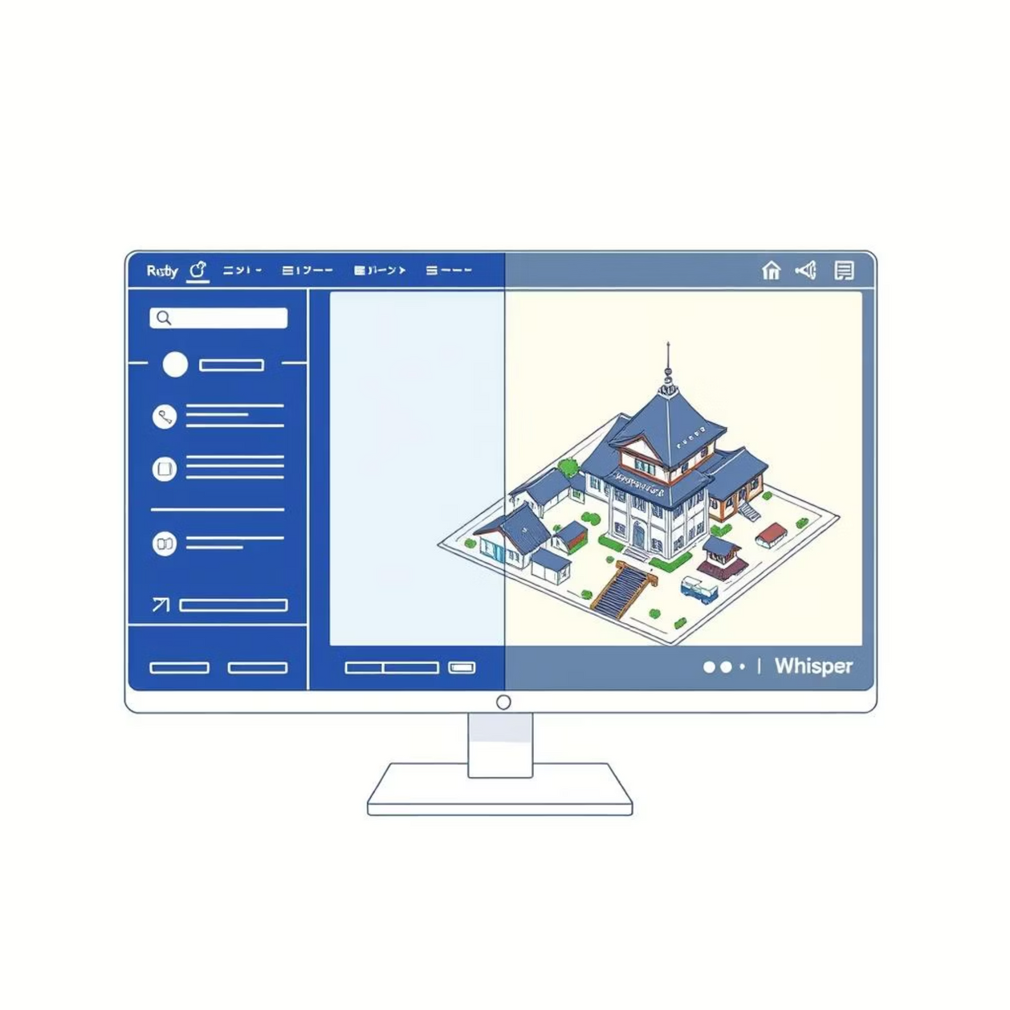
Our Solution: An Intuitive Web-Based 3D Designer
We propose a web-based platform that leverages modern web technologies to make 3D design accessible:
Split-screen Interface: Left control panel for settings, right 3D viewport for visualization.
Interactive Elements: Click any object to open a style/template panel.
Dynamic Manipulation: Drag, move, and resize elements with live dimension feedback.
Cloud Persistence: Save and export projects seamlessly via a backend system.
Notes:
6

Slide 6
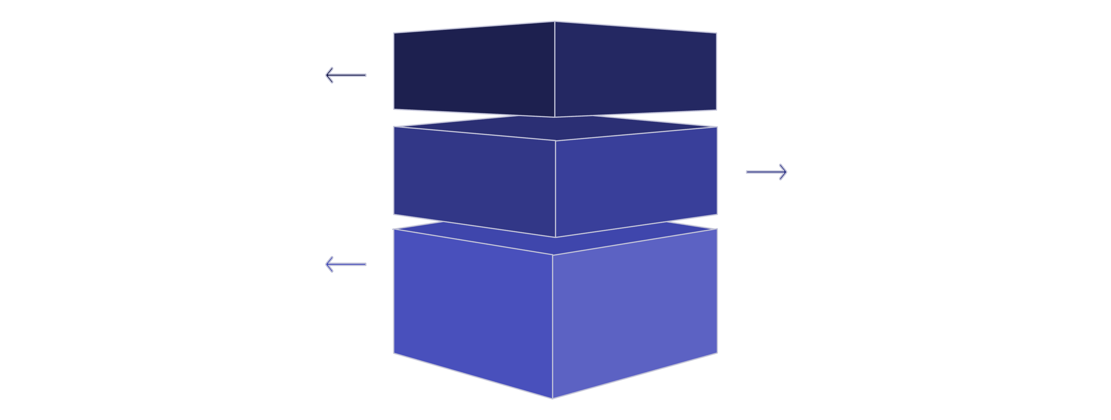
Robust & Scalable Architecture
Frontend
React + Three.js UI for interactive 3D experiences.
Backend
Node.js + Express handling API logic and auth.
Data & Storage
MongoDB/Firebase + Cloud Storage for 3D models.
Our architecture is designed for performance, scalability, and ease of development, separating concerns across distinct layers.
Notes:
7

Slide 7




Key Features & Powering Tech Stack
Rich Template Library
Intuitive 3D Editing
Effortless drag & drop functionality for all compound elements.
Access a diverse collection of prebuilt designs and styles.
Cloud Project Management
Flexible Export Options
Save, load, and manage projects securely in the cloud.
Export designs as images or glTF models for broader use.
Tech Stack: React, Tailwind, shadcn/ui, Three.js, Zustand, Node.js, MongoDB
Notes:
8

Slide 8
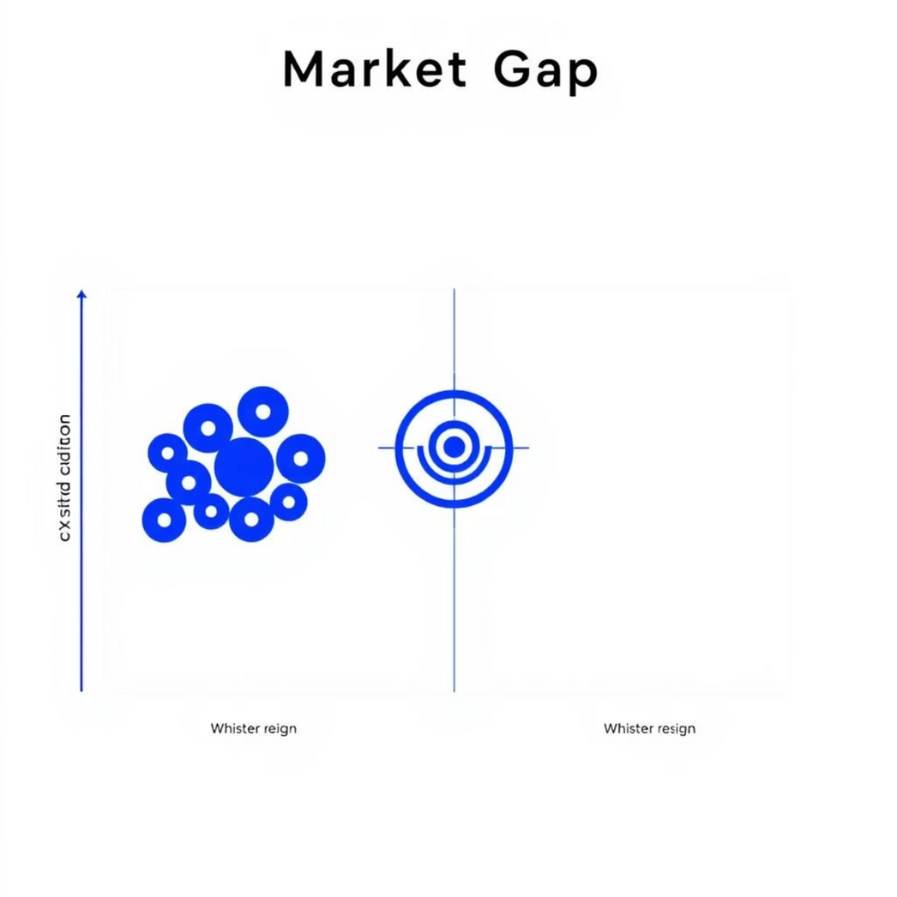
Market Validation: Proving the Demand
The success of platforms like Planner 5D, Roomstyler, and HomeByMe demonstrates a clear user demand for accessible visual design tools.
Planner 5D: Focuses on interior home design.
Roomstyler: Offers virtual room planning and decorating.
HomeByMe: Provides 3D home planning and interior design.
However, none of these platforms specialize in compound-level outdoor 3D layout editing with instant, interactive templates. This gap represents a significant opportunity for our solution.
Notes:
9

Slide 9
Target Users & Use Cases
Individual Homeowners
1
Empowering anyone to easily design their villa compounds, gardens, and outdoor spaces.
Architects & Design Firms
2
Accelerating initial concept generation and client presentations with rapid prototyping.
Real Estate Developers
3
Showcasing detailed site plans and property layouts to potential buyers in an engaging 3D format.
Educational Institutions
4
Providing an accessible learning tool for architecture and design students.
Notes:
10

Slide 10
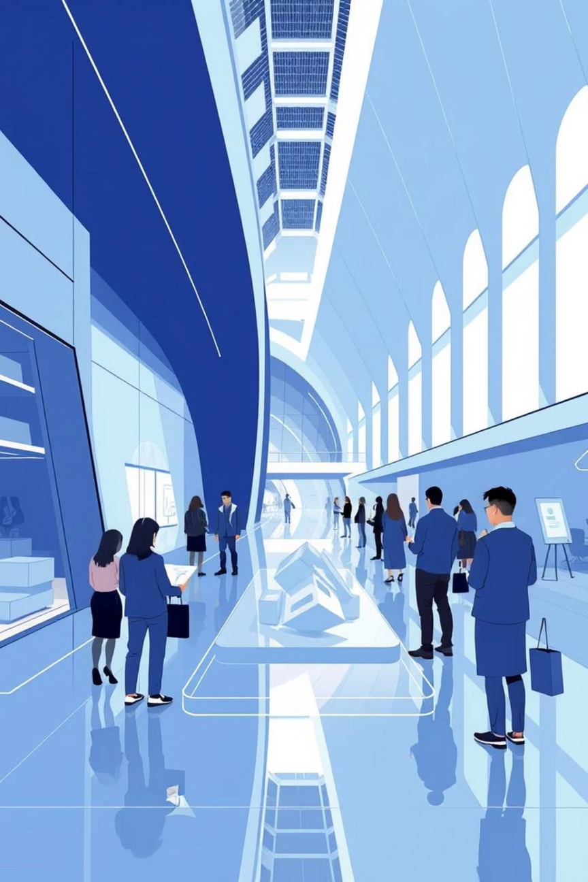

Future Scope & Call to Action
Collaborative Editing: Multi-user real-time design sessions.
AI Auto-Layout: Intelligent recommendations for compound elements.
AR Mobile Preview: WebXR integration for augmented reality previews on-site.
Contractor Integration: Seamless workflow from design to cost estimates.
We seek support and mentorship to bring this vision to life!
Notes:
11

